Slide 1
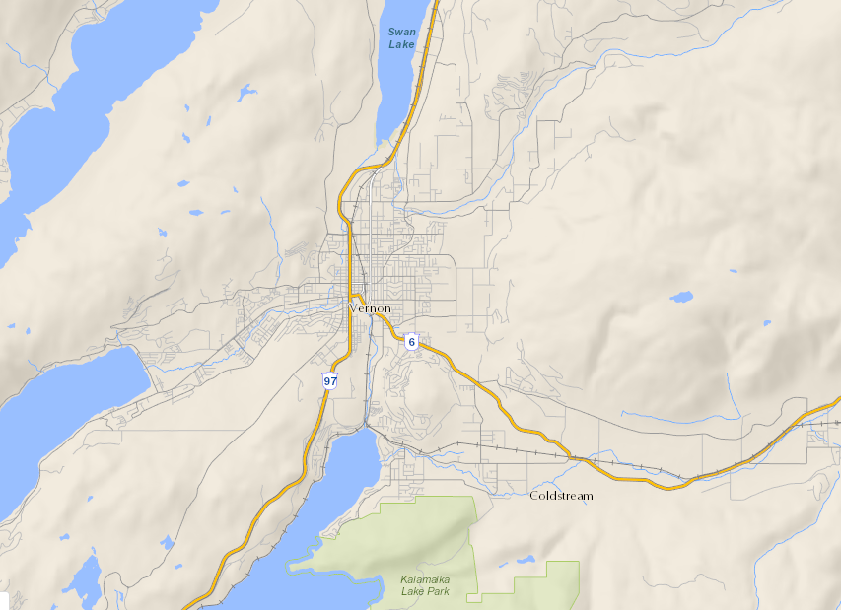
Using Avenza Maps
Notes:
Hi everyone, today I’ll be talking to you about an incredibly useful tool for fieldwork. Avenza maps is a simple, easy to use app that will help prevent situations such as this…

Slide 2
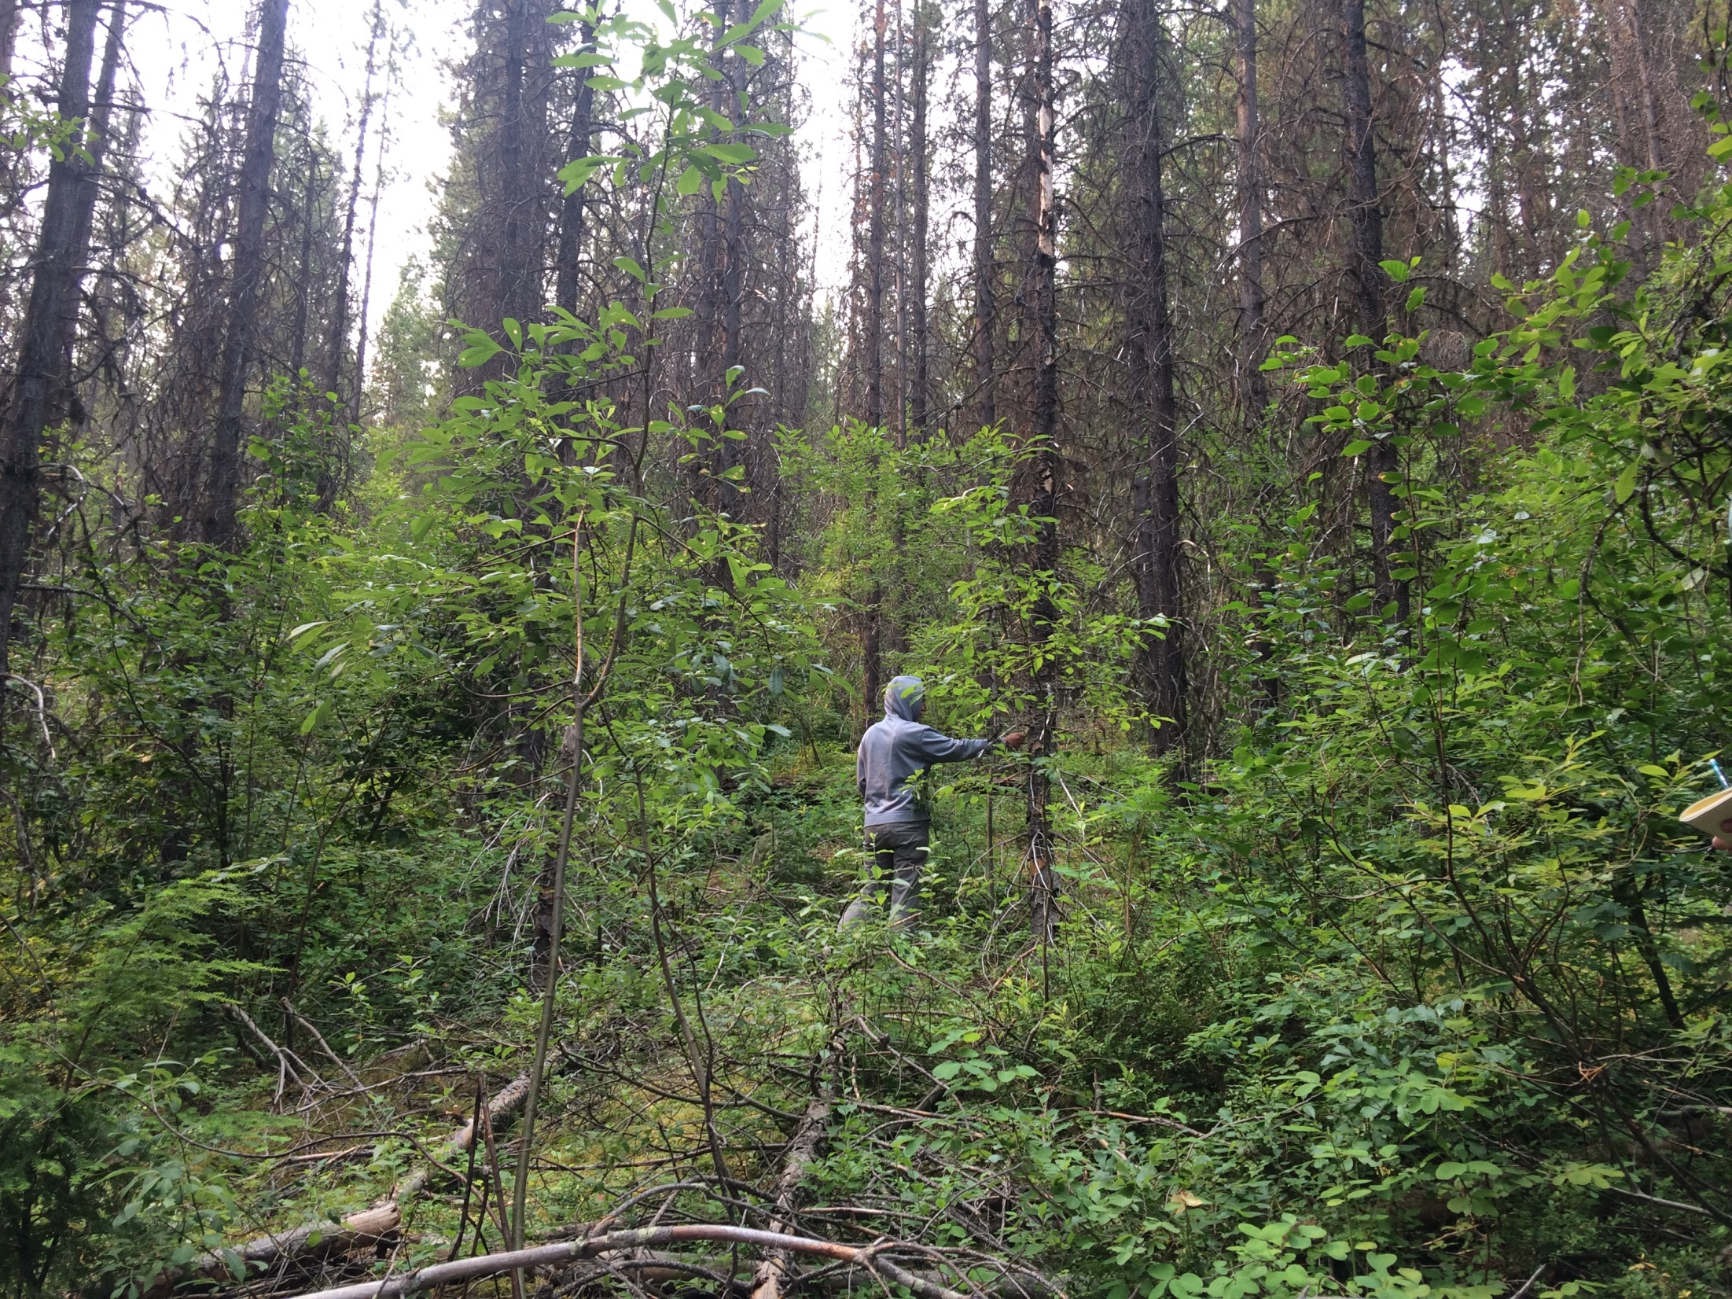
All these trees look the same
Notes:
I’m sure everyone here can relate to spending way too much time scouring the bush for a field site which just doesn’t want to be found or trying to decipher confusing access notes that were made back when Trudeau Senior was prime minister. Luckily, Avenza is here to help

Slide 3
First: What is Avenza?
Straightforward mapping tool
Uses georeferenced PDFs or GeoTIFFs
Works a bit like Google maps, but offline
Notes:
Avenza is a really easy to use, straightforward mapping tool that’s great for fieldwork. Using maps in the form of PDFs and GeoTIFFs, it can be used for navigation virtually anywhere. It will show you where you are on a given map that you create, taking a lot of the guesswork out of navigation. Don’t worry about not having access to internet or cell service, since it works using your device’s internal GPS and doesn’t require either of those things to accurately determine your location. This makes it perfect for finding your way to remote field sites without having to struggle with potentially outdated maps or access notes.

Slide 4
What do you need?
Any GIS program that can produce georeferenced PDFs or GeoTIFFs
iMap BC and ArcMap are the most common options
Notes:
All you need to create your own georeferenced maps is a GIS program that can produce georeferenced PDFs or GeoTIFFs. iMap BC and ArcMap are both great options, depending what you have access to and your intended goals. ArcMap is great if you have access to the right layers, but it’s quite an unwieldy program. iMap is a lot easier and quicker, but produces lower resolution and less detailed maps

Slide 5
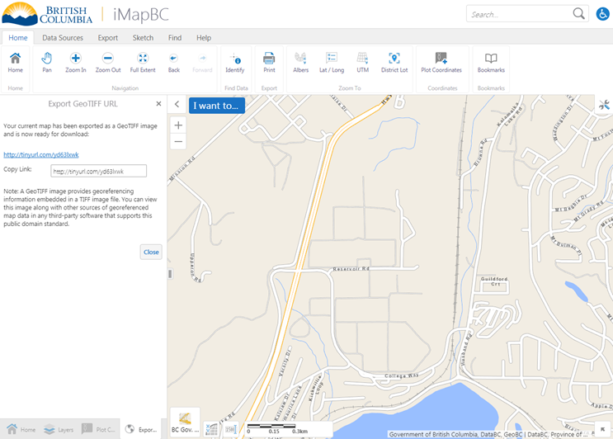
Notes:
First, choose the area you want to map and the scale you want it at. You can find coordinates using the plot coordinates function in iMap or find coordinates function in ArcMap

Slide 6
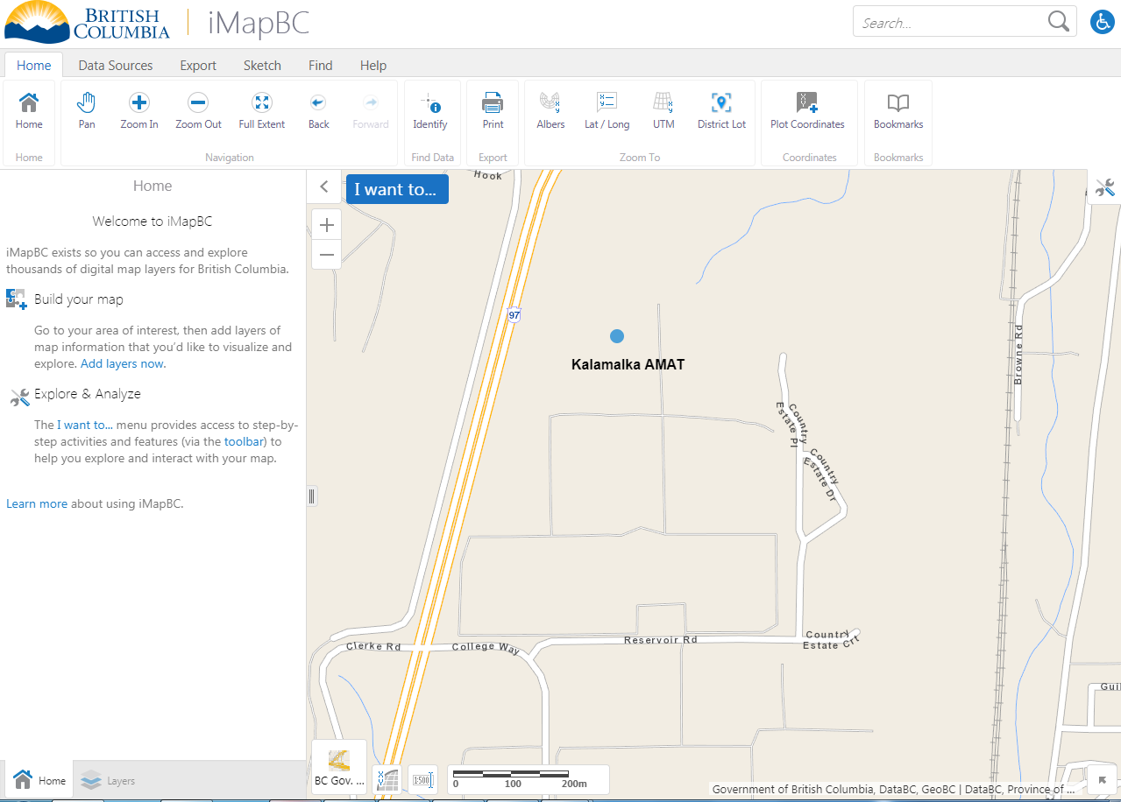
Notes:
In iMap you can add labels, points, and shapes to the map to mark features

Slide 7
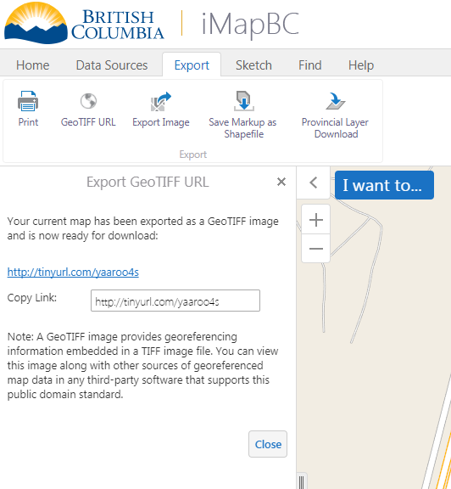
Notes:
When you’re happy with your map, convert it to GeoTIFF/PDF format and add it to Avenza. In iMap this is done by selecting the generate GeoTIFF URL function

Slide 8
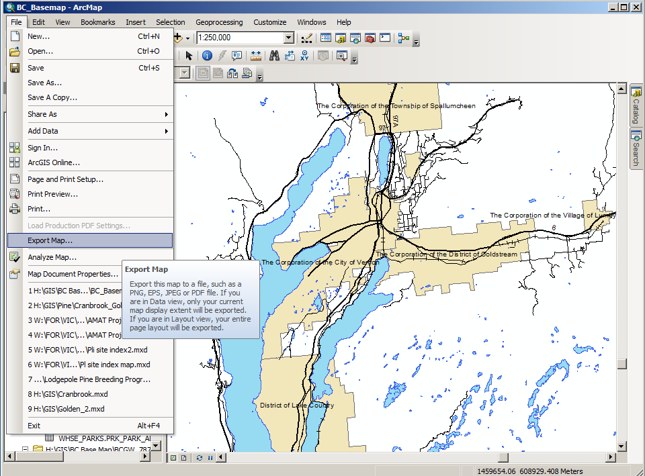
Notes:
If you’re using ArcMap, use the export map function

Slide 9
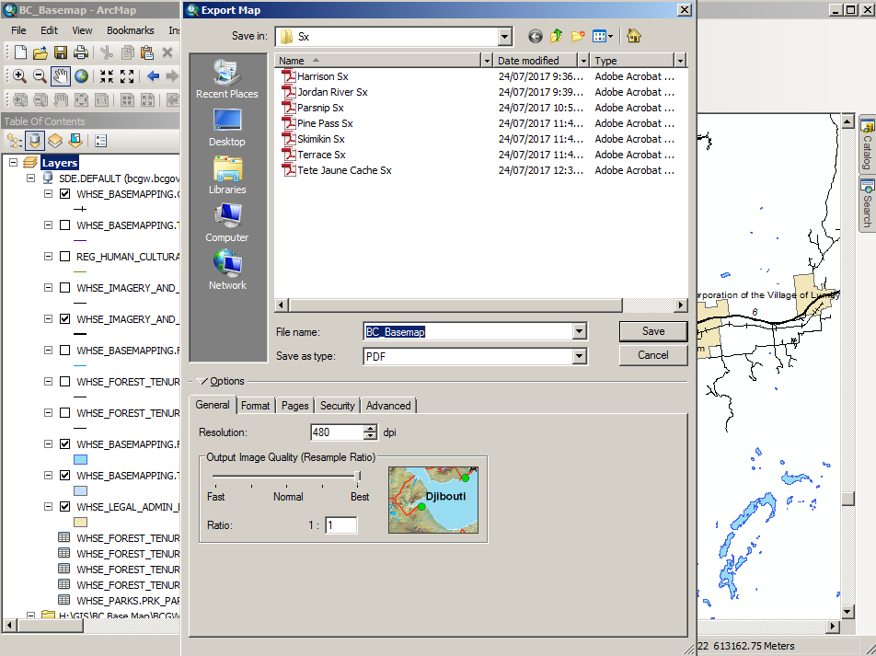
Notes:
This will bring up a screen that allows you to export the map to pdf and make adjustments in terms of PDF quality

Slide 10
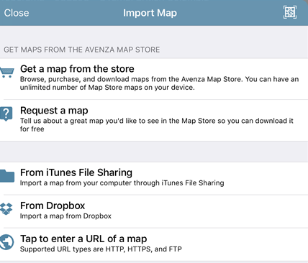
Notes:
Once you’ve got the URL or file, enter it into Avenza. With iMap you can easily enter the URL you just generated. For Arc and other GIS programs, you can transfer the PDF file to Avenza using iTunes file sharing or dropbox

Slide 11
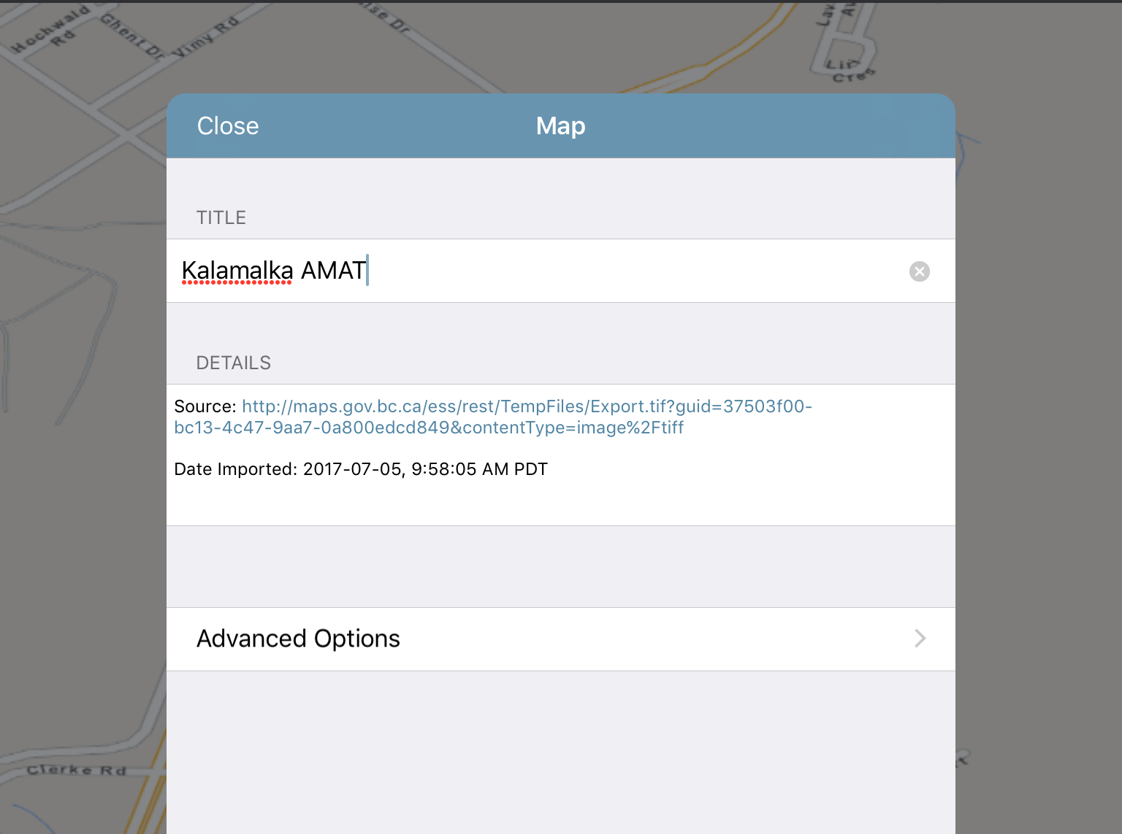
Notes:
Now that you have your map loaded, you can rename it, add layers, and view your location with respect to the map

Slide 12
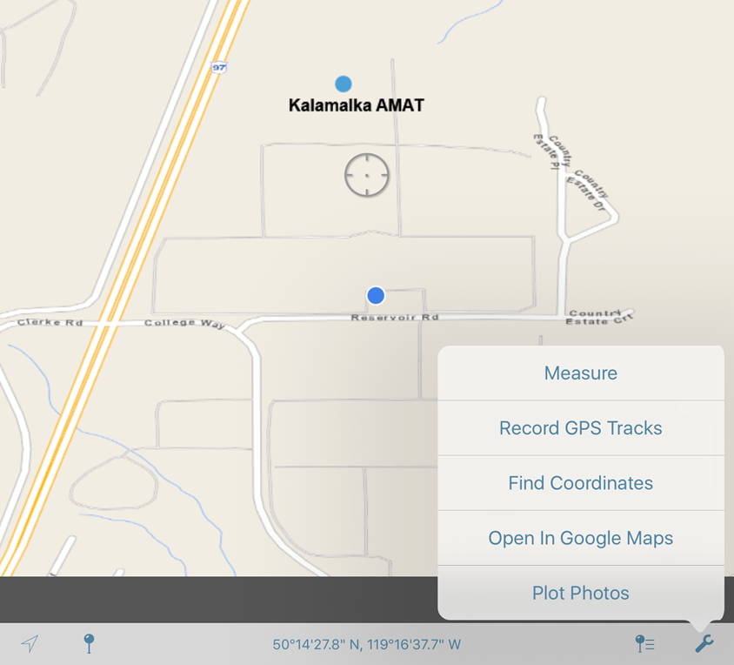
Notes:
You can also record GPS tracks, find coordinates on the map, and measure distances. The blue dot outlined in white represents your location, the solid blue dot is the AMAT site which we marked in iMap.

Slide 13
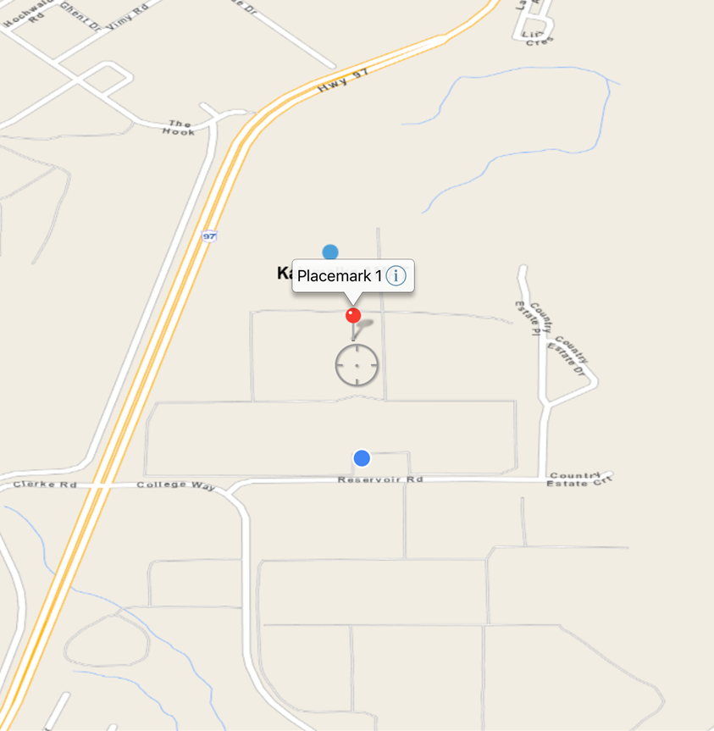
Notes:
You can add and edit placemarks at specific coordinates if you want to mark anything on the map after you’ve loaded it in Avenza

Slide 14
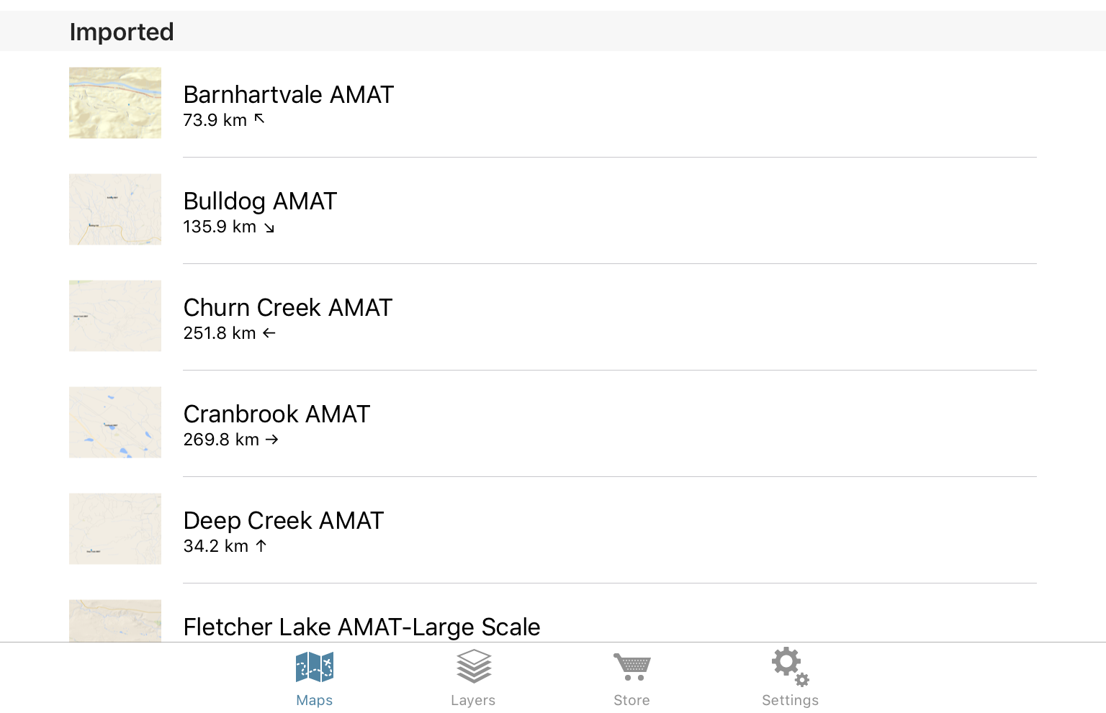
Notes:
It will also show you the distance and direction to any given map

Slide 15
Some Considerations
The BC government roads layer in iMap shows forest service roads in the most detail
Try to include the entire route in your map, from highway to site
ArcMap will show all layers at every scale whereas Avenza won’t
Notes:
Some important considerations when making maps in Avenza.

Slide 16
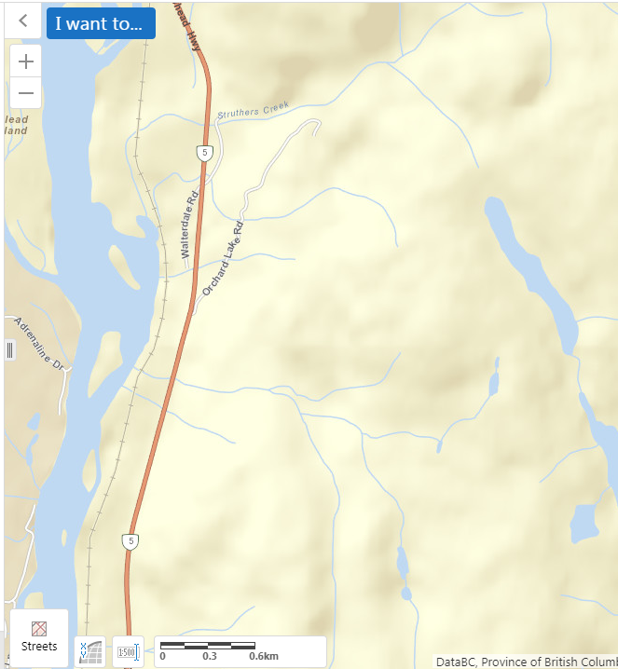
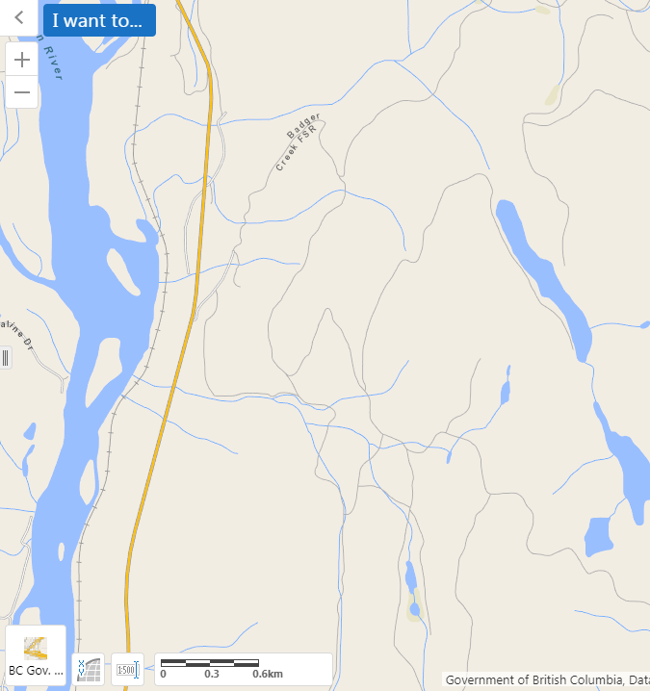

Notes:
The BC government roads layer in iMap shows forest service roads in the most detail. Its different than the default streets layer, so look out for that if you can’t see any forest service roads around the field site. If you’re making a map of a route to a field site, try to include as much of the route as possible for ease of navigation.

Slide 17
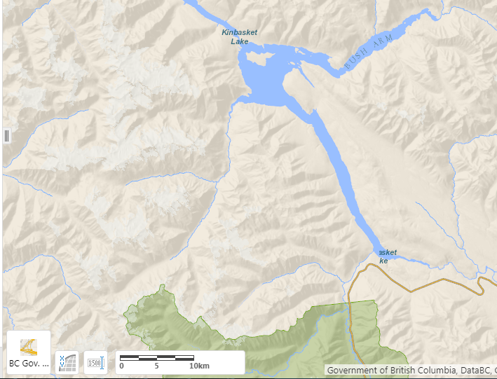
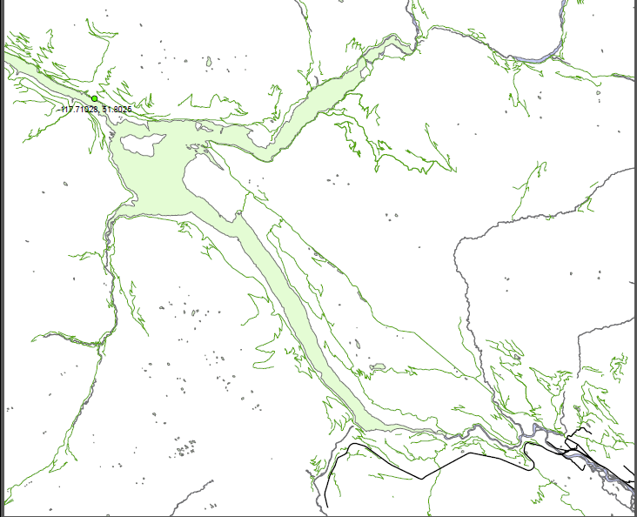
iMap BC
ArcMap
Notes:
As you zoom out in iMap, the forest service road will disappear at a certain scale whereas forest roads can be viewed at all scales in Arc. This can be helpful for sites which are far away from major highways or towns. It can also produce higher resolution maps, which look nice. On the other hand, it’s a lot slower and harder to work with than iMap. Also, you can’t always trust that the coordinates in the access notes are accurate, so take that with a grain of salt and be aware that the site may not be exactly where it says on the map.

Slide 18
Thanks for Listening!

